Slide 1

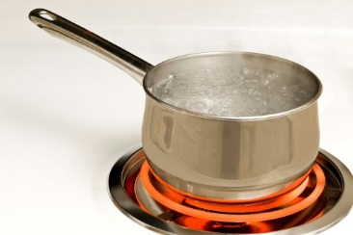
BOIL WATER ORDER
The Murray Water System has issued a boil water order until further notice for the customers on Payne Street from 10th to 12th Streets.
Questions regarding this order should be directed to:
Murray Water System
270-762-0336

