Slide 1


BOIL WATER ORDER
The water dept is changing a fire hydrant and will issue a boil water order for the following:
Poplar from S. 13th to S. 15th; S. 15th from Poplar to Main
Questions regarding this order should be directed to:
Murray Water Systems – 270-762-0336

Slide 2
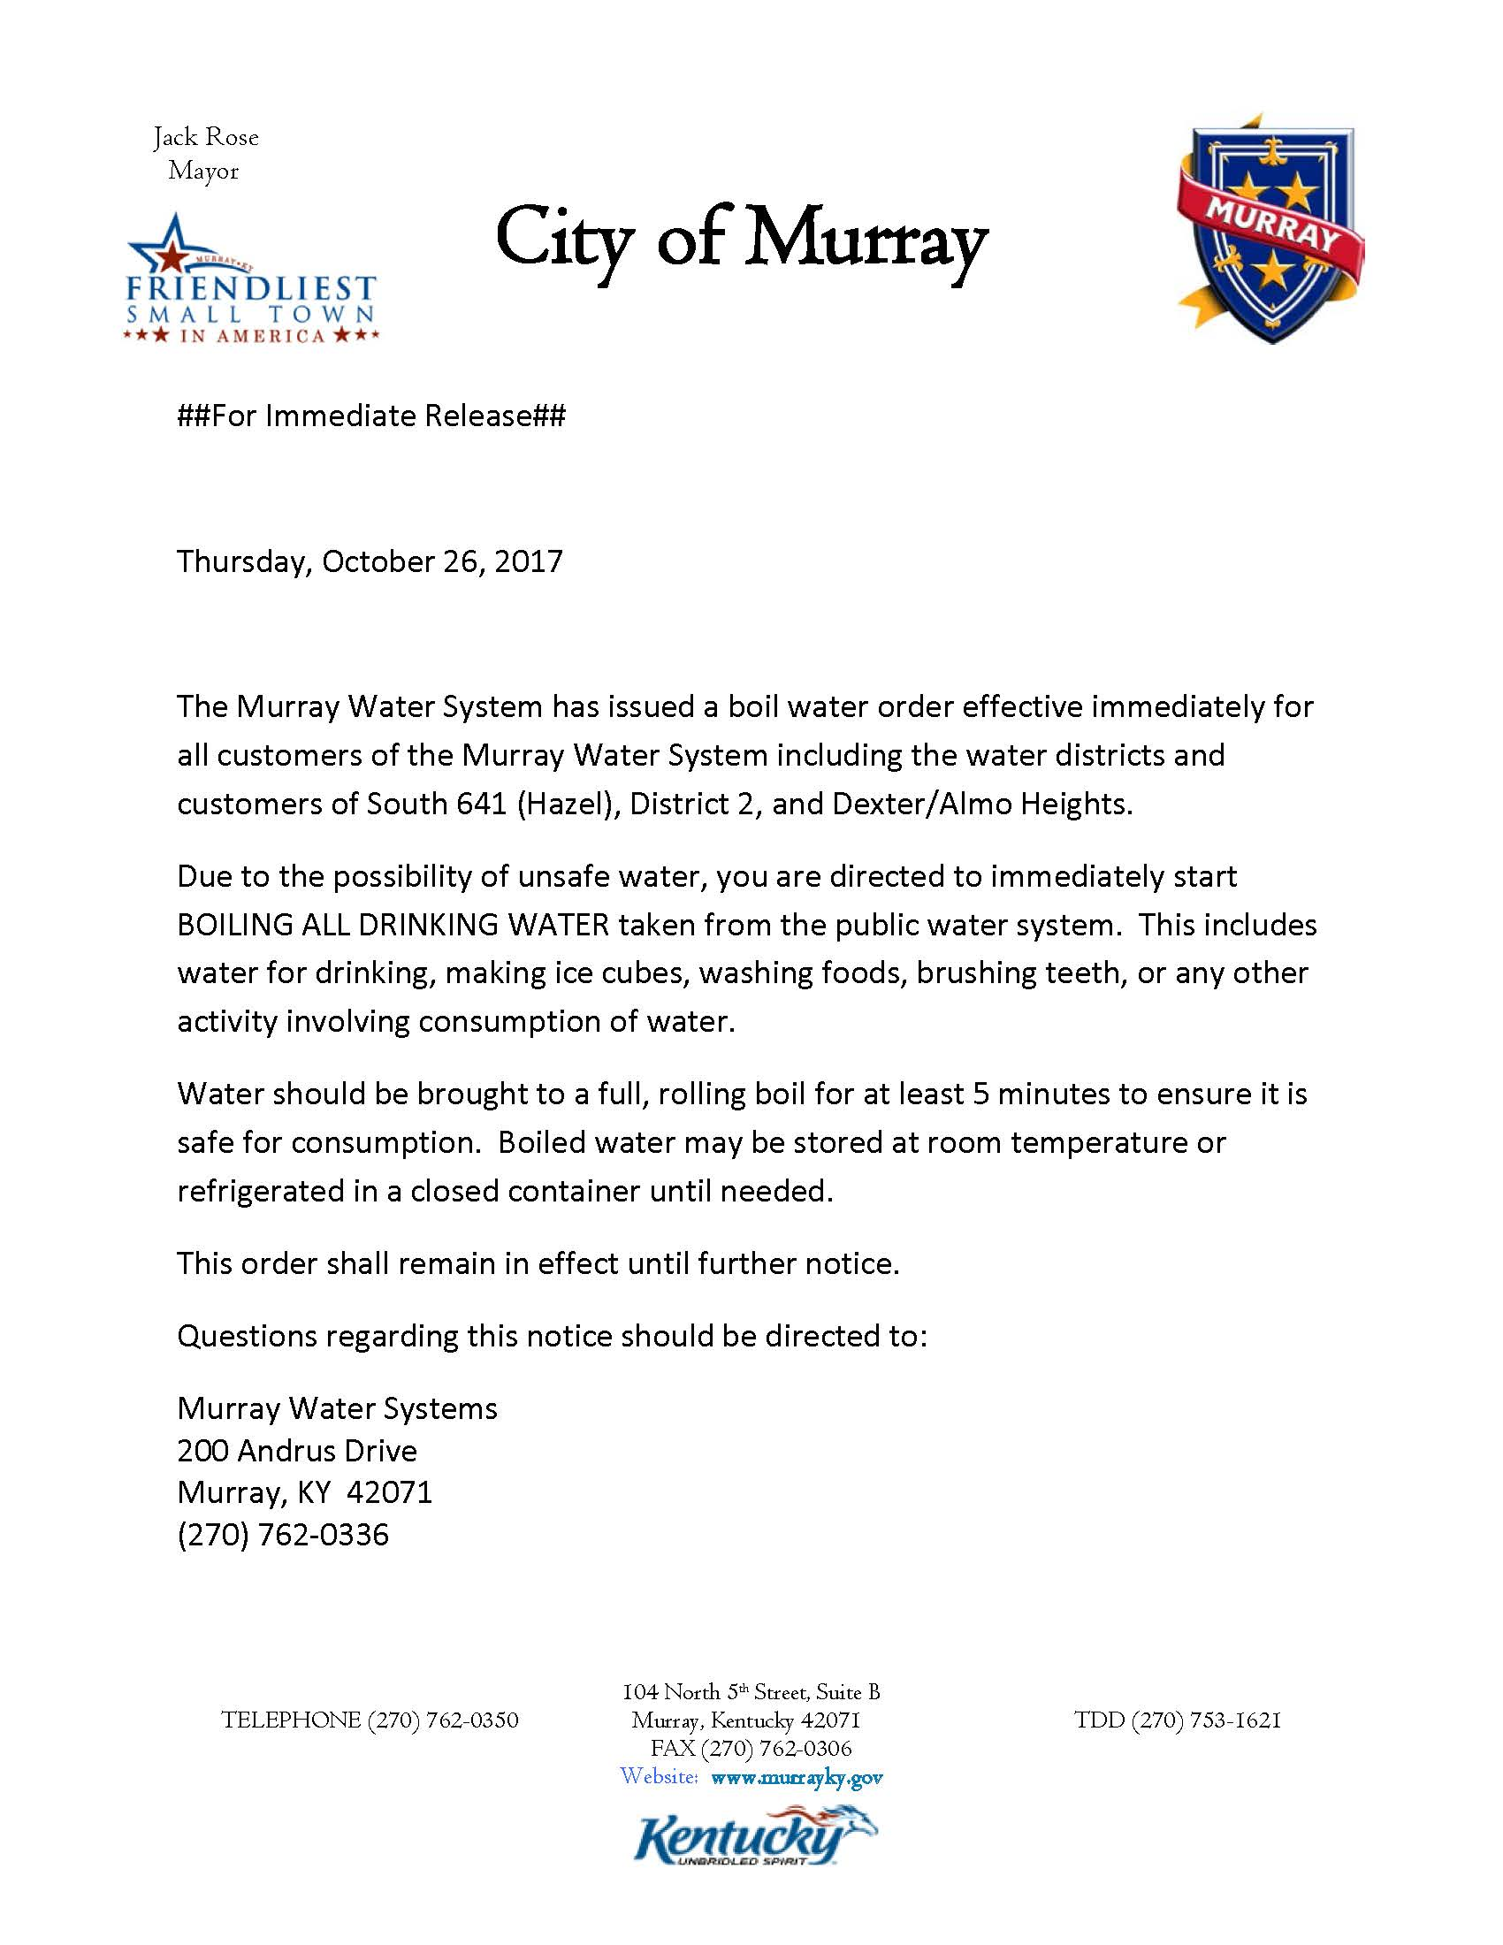

Slide 3
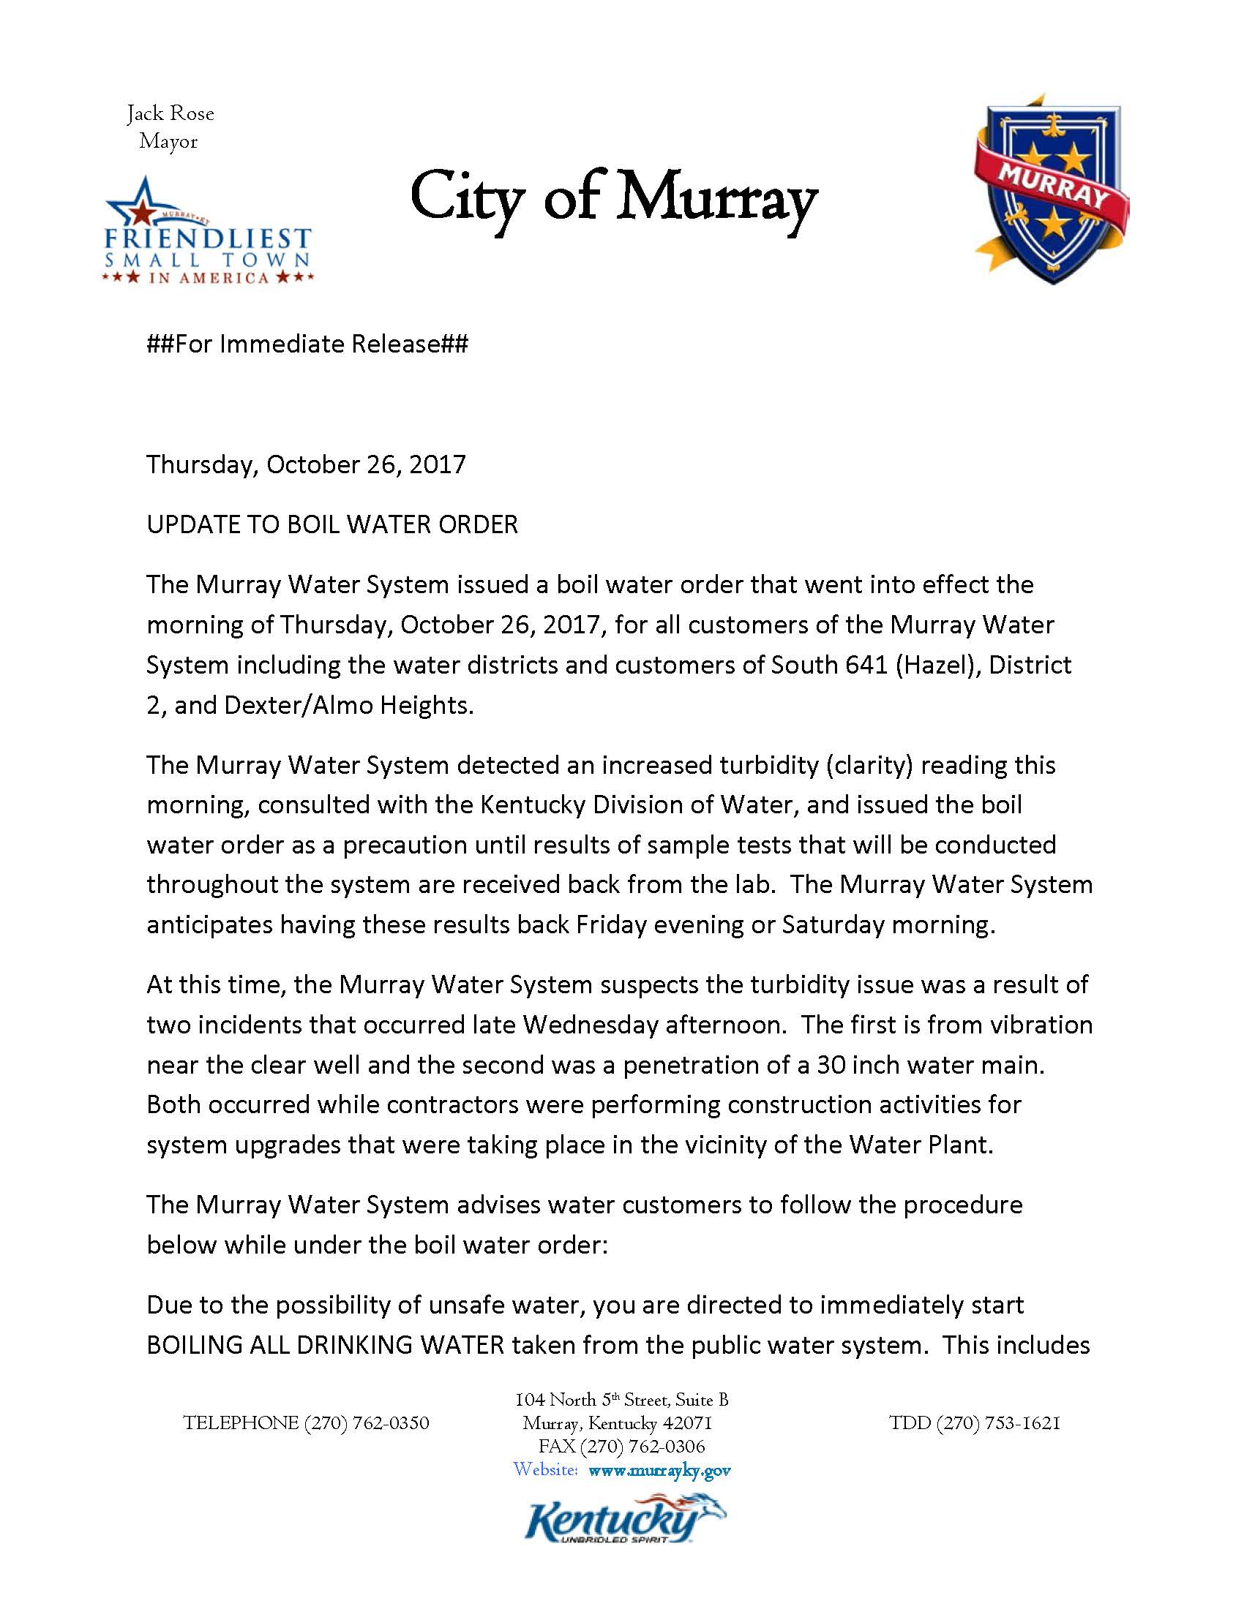
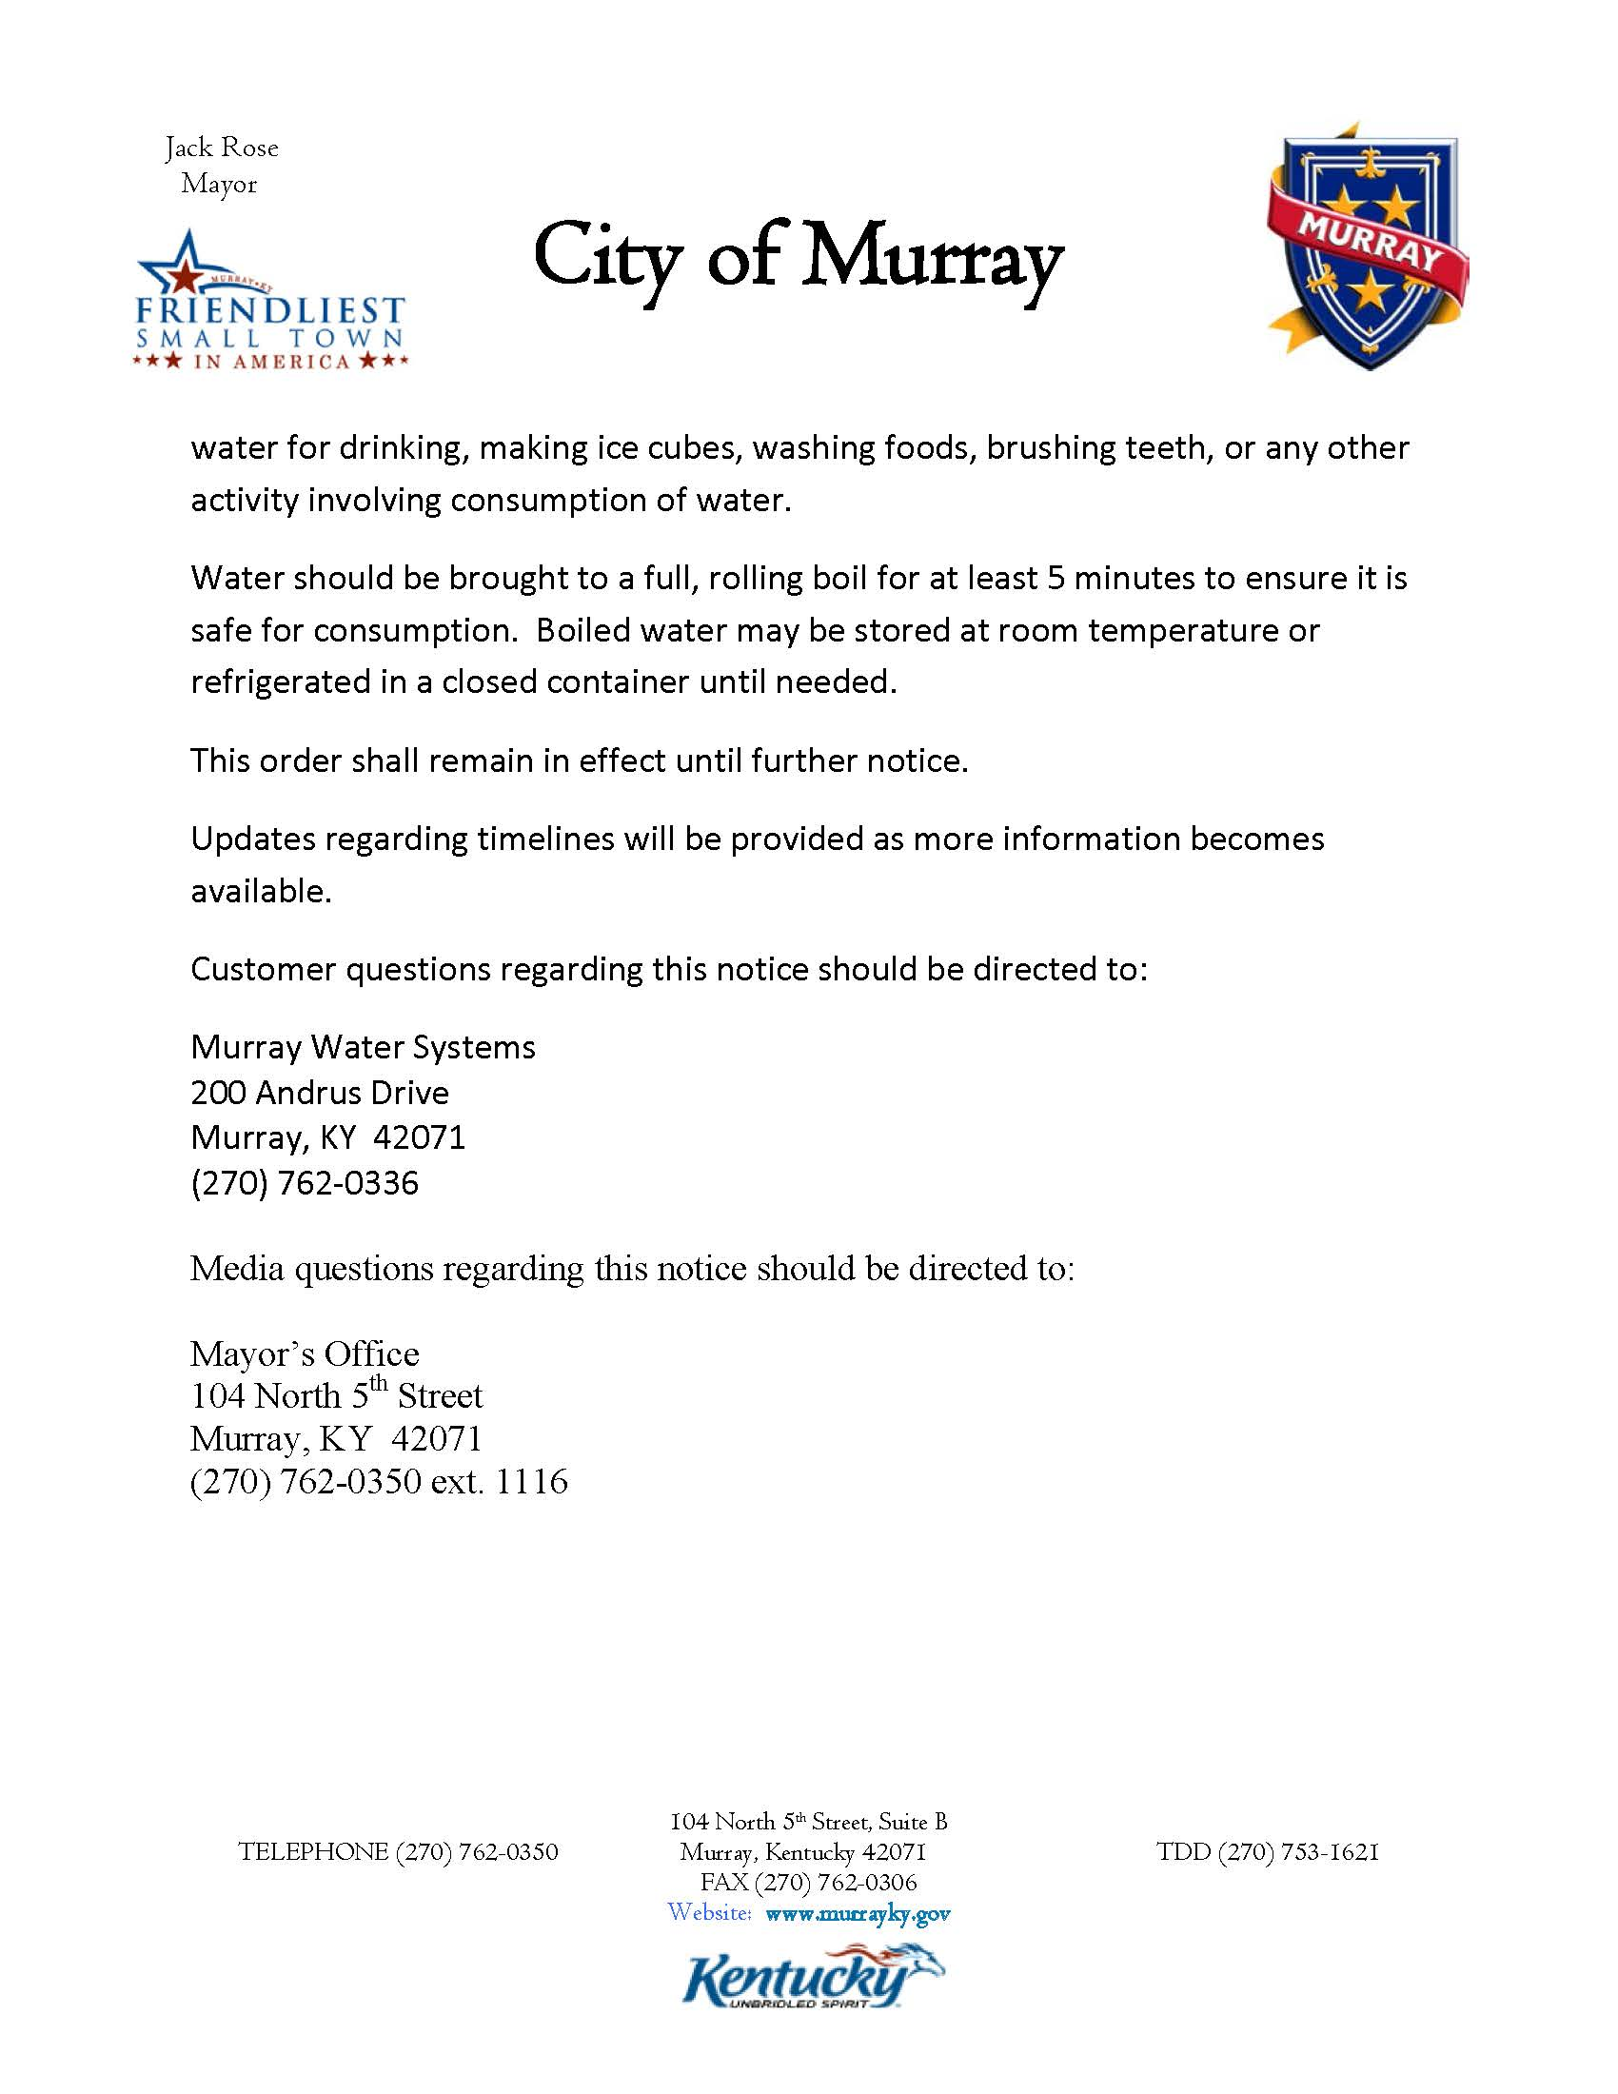

Slide 4
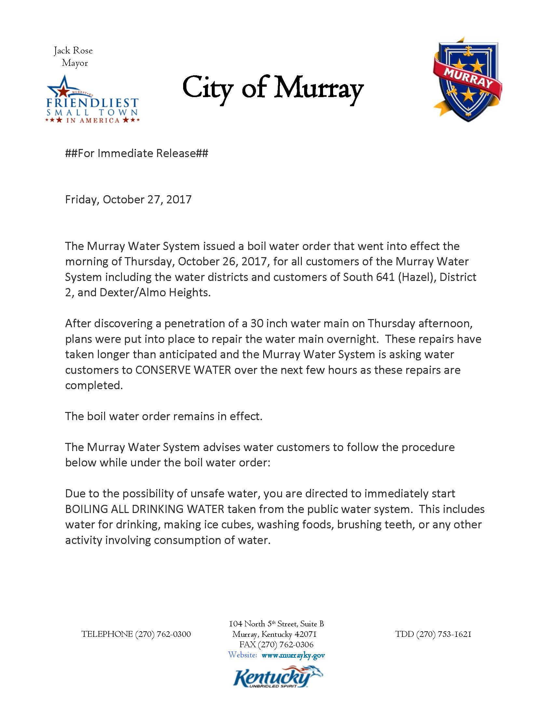
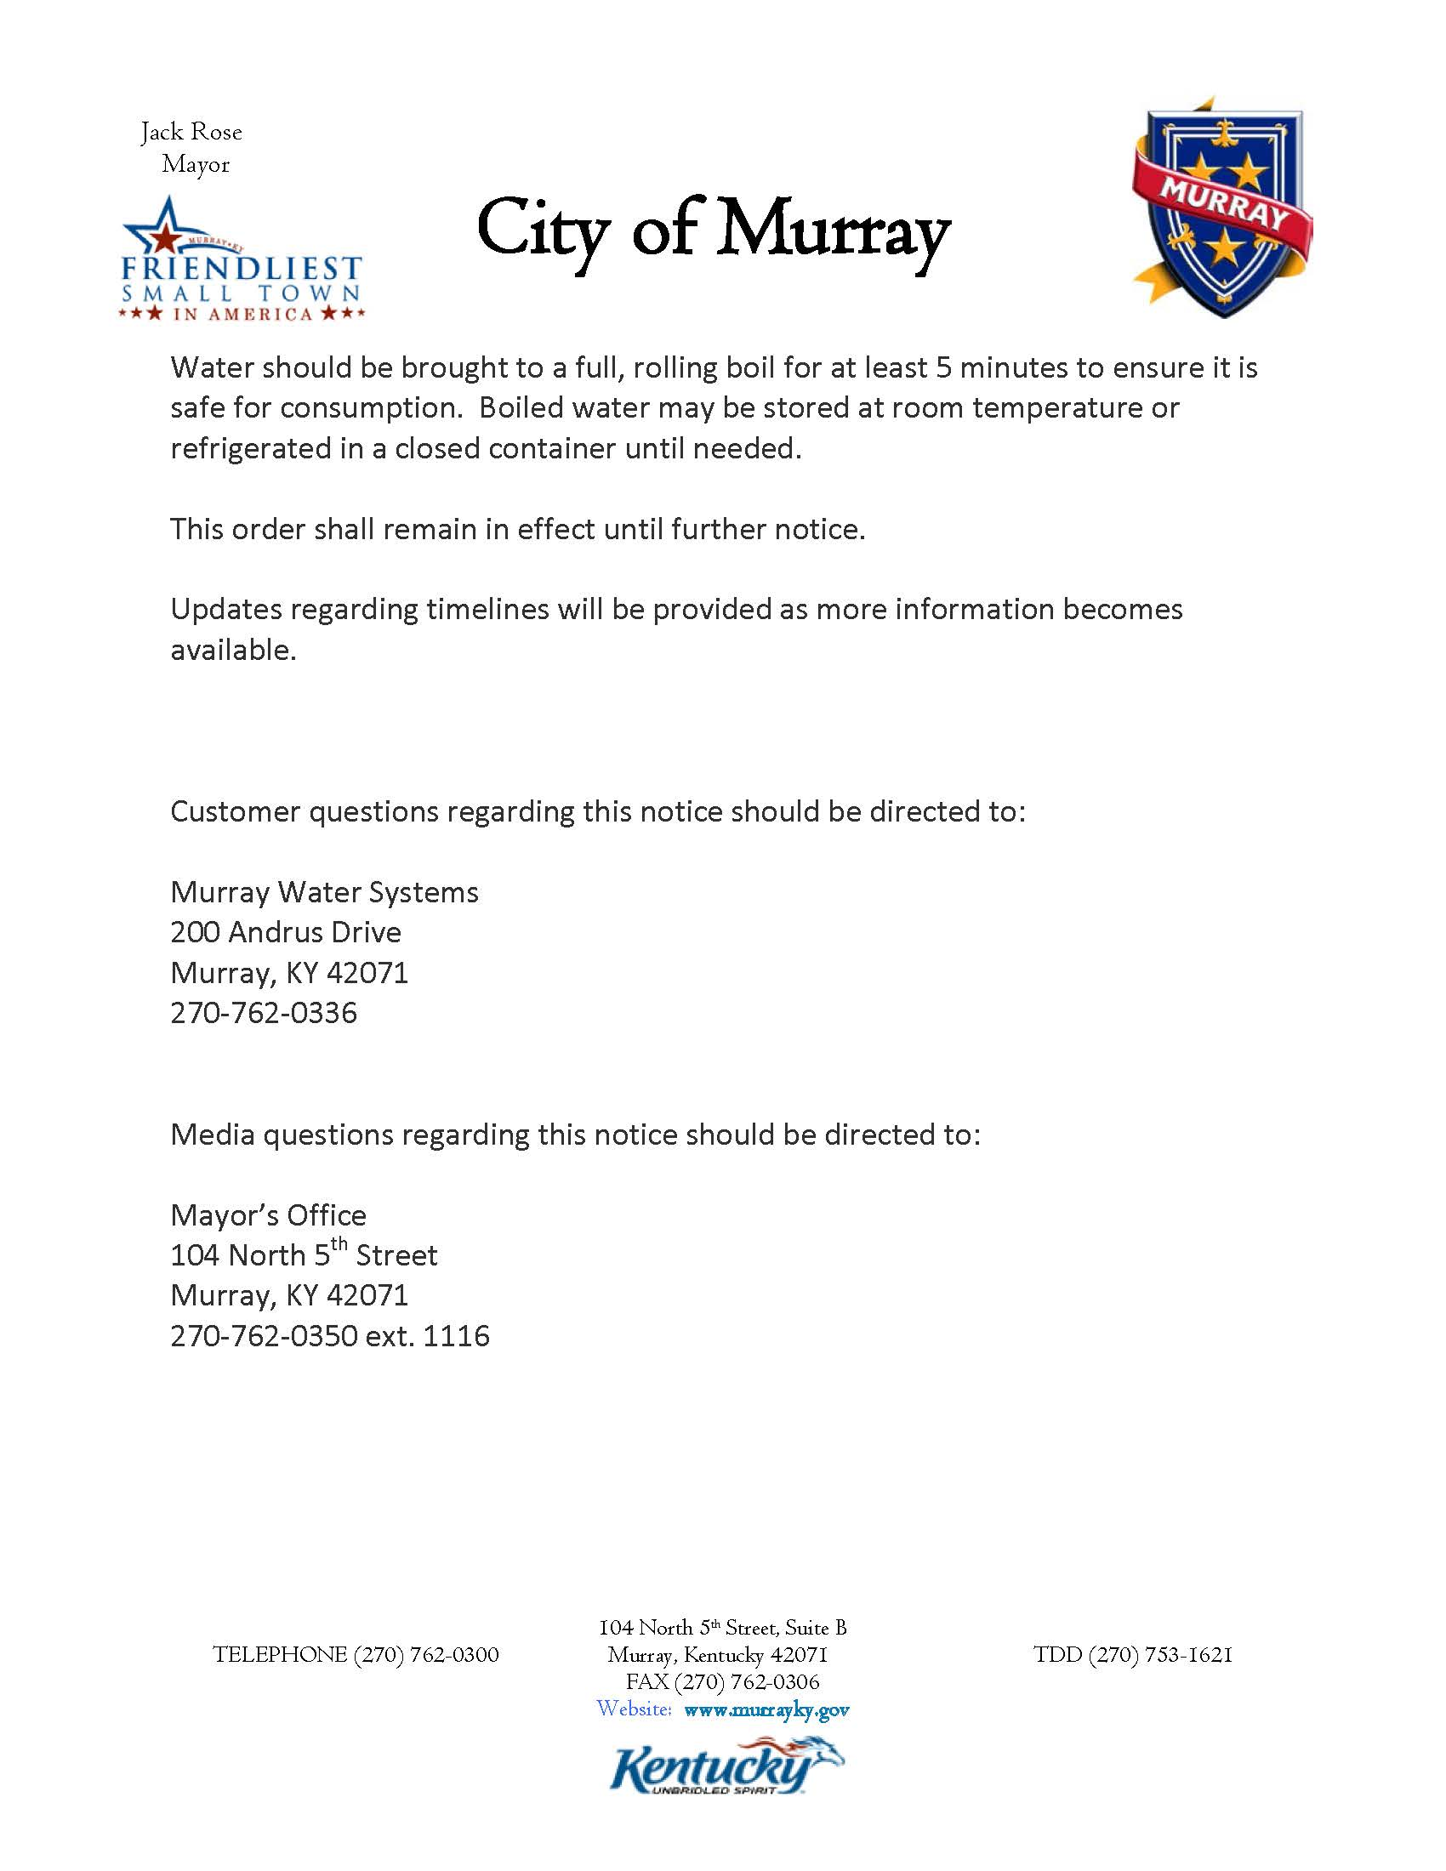

Slide 5
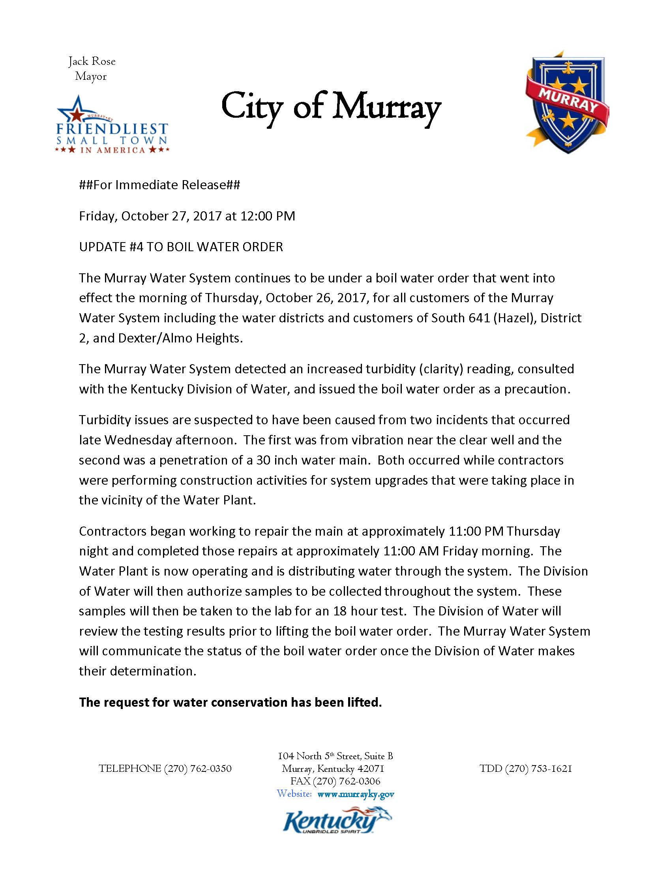
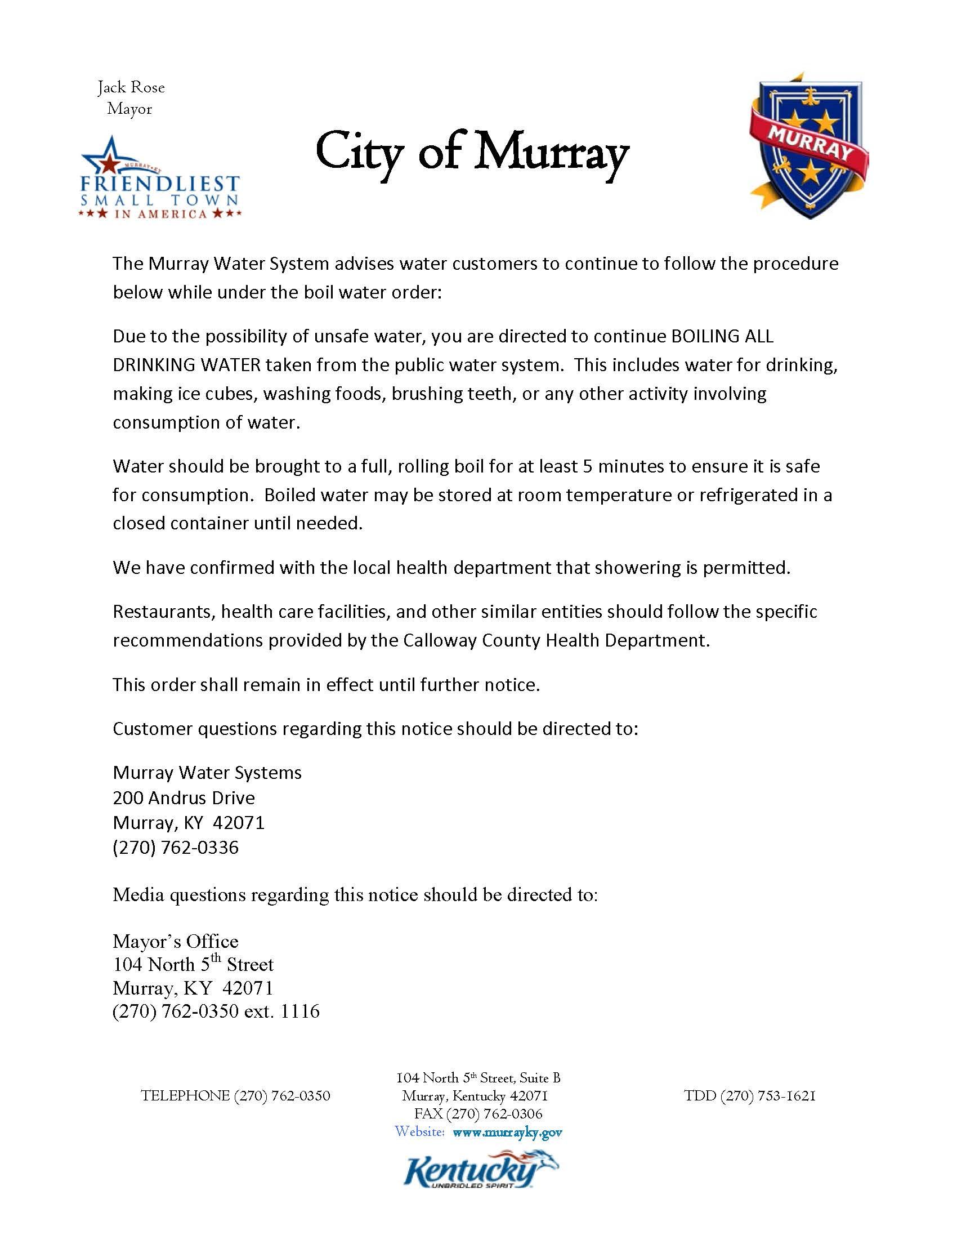

Slide 6
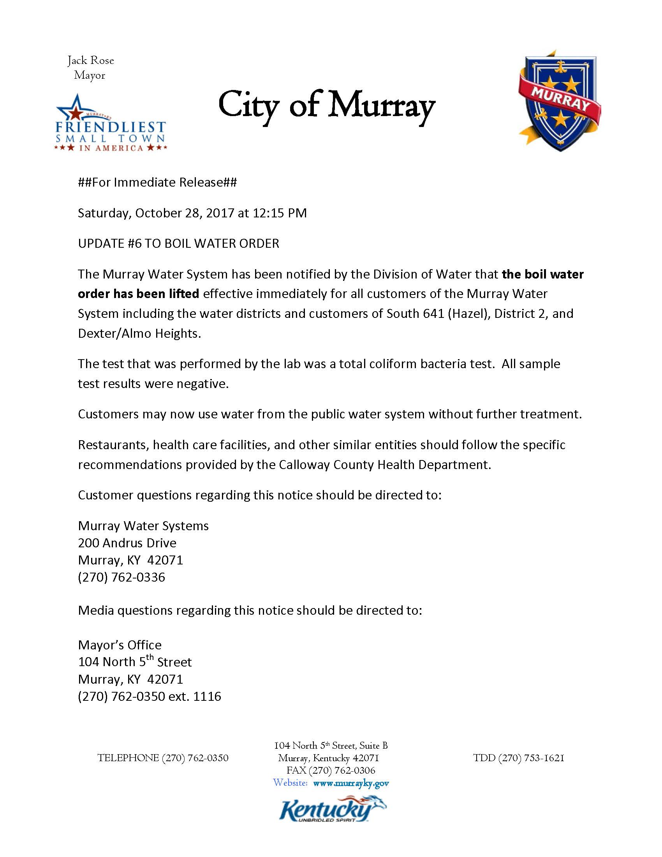

Slide 7
BOIL WATER ORDER LIFTED
The following businesses are no longer under a boil water order:
All of the Bel-Air Shopping Center
All businesses on Whitnell Rd. (from Glendale Rd. to Story Ave.)
Primary Care
The Crew
Paint Plus
Jarvis Vision Center

Slide 8
BOIL WATER ORDER
A boil water order has been issued until further notice, for the following:
All of the Bel-Air Shopping Center
All businesses on Whitnell Rd. (from Glendale Rd. to Story Ave.)
Primary Care
The Crew
Paint Plus
Jarvis Vision Center

Slide 9
BOIL WATER ORDER HAS BEEN LIFTED
City of Murray water customers south of Applewood Drive are no longer under a boil water order as of 11-14-15.

