Slide 1
The Transfer Station will be closed on January 1, 2019 for the New Year Holiday.
We will re-open January 2, 2019.

Slide 2
Transfer Station Landfill Road
Will be closed Monday for the Memorial Day Holiday

Slide 3
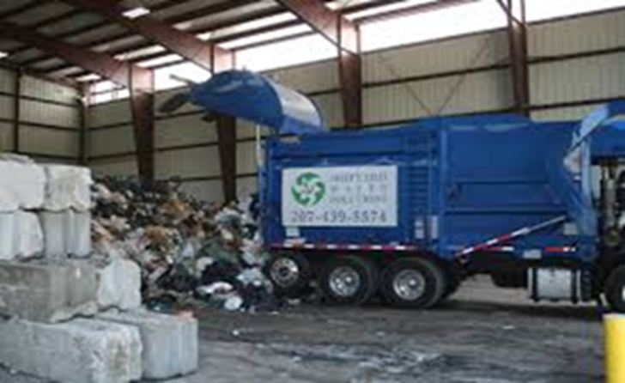
Transfer Station Landfill Road
The Transfer Station will be closed on July 4, 2019 Independence Day Holiday, Thursday, July 4th, 2019.
We will re-open July 5, 2019

Slide 4
Transfer Station Landfill Road
Will be closed Monday September 2 for the Labor Day Holiday

Slide 5
Transfer Station Landfill Road
Will be closed Thursday November 28 for the Thanksgiving Holiday, but will be open to the public on Friday, November 29.

Slide 6
Transfer Station Landfill Road
The Transfer Station will be closed to the public on Christmas Eve and Christmas Day.

