Slide 1
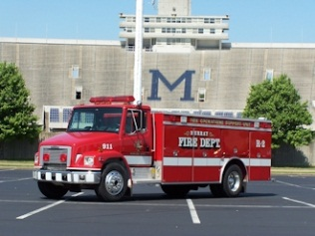
The City of Murray is accepting applications for a Fire Inspector. Applications may be submitted at www.murrayky.gov/jobs until 4:00 p.m. on Monday, May 18, 2015.

