Slide 1
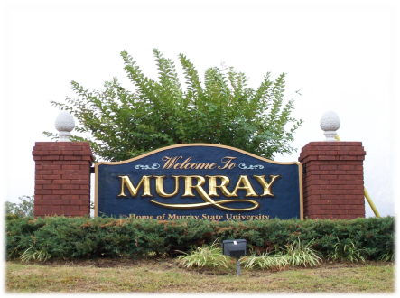
CITY COUNCIL MEETING
City Council will meet on
January 10, 2019 at 6 p.m.
in the Council Chambers of City Hall at 500 Main Street. Everyone is welcome to attend. You may also watch the meeting on your local Government Access Channel.

Slide 2
SPECIAL CALLED
CITY COUNCIL MEETING
City Council will meet on Monday, May 8, 2017 at 4:00 p.m. in the Council Chambers of City Hall.

Slide 3
CITY COUNCIL MEETING RESCHEDULED
The City Council meeting on January 12, 2017 has been rescheduled to January 9, 2019. They will meet in the Council Chambers of City Hall. Everyone is welcome to attend. You may also watch the meeting on your local Government Access Channel.

Slide 4
The City Council will attend a dinner at Oakhurst on October 17, 2016. The reception will begin at 6:00 p.m. with dinner following at 6:30 p.m. at the invitation of Dr. Davies. No business will be conducted.

Slide 5
The City of Murray Planning Commission will meet January 17, 2019 at 4:30 p.m. in the Council Chambers of City Hall.

Slide 6
The June 20, 2019 meeting of the City of Murray Planning Commission has been cancelled.

Slide 7
The City of Murray Board of Zoning Adjustments will meet on December 18, 2019 at 4:30 p.m. in the Council Chambers of City Hall.

Slide 8
The City of Murray Board of Zoning Adjustments will have a special-called meeting on February 8, 2019 at 4:30 p.m. in the Council Chambers of City Hall.

Slide 9
MEETING CANCELLED
The City of Murray Board of Zoning Adjustments meeting scheduled for January 17, 2019 has been canceled.

Slide 10
Meeting
The Human Rights Commission will meet on December 9, 2019 at 4:00 p.m. in the Council Chambers of City Hall.

Slide 11
Meeting Rescheduled
The April Human Rights Commission meeting has been rescheduled for April 23, 2019 at 4:00 p.m. in the Council Chambers of City Hall.

Slide 12
Meeting Cancelled
The Human Rights Commission meeting
For April has been
Cancelled

Slide 13
MEETING
The City of Murray Cable Commission will meet on October 23, 2019 at 4 p.m. in the Council Chambers of City Hall.

Slide 14
MEETING CANCELLED
The City of Murray Cable Commission meeting scheduled for May 23, 2019 has been cancelled.

Slide 15
MEETING
The City of Murray Code Enforcement Board will meet on December 3, 2019 at 5 p.m. as needed in the Council Chambers of City Hall.

Slide 16
MEETING
The City of Murray Code Enforcement Board meeting on February 5, 2019 has been cancelled.

Slide 17
MEETING
The City of Murray Downtown Revitalization Committee will meet Tuesday July 9, 2019 at 4:00 p.m. in the Council Chambers of City Hall.

