Slide 1

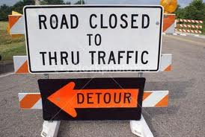
Street Closings
Diuguid Drive between North 16th Street and Bourland Lane will be closed to thru traffic beginning Monday, November 13th, 2017 until Monday, November 27^{th,} 2017.
The street will be closed for stormwater infrastructure repair work. We are sorry for any inconvenience this may cause.

Slide 2
Update on City Street Closures:
North 3rd St. between Main and Walnut has been reopened to traffic. All other Street and Alleyway closures remain in full effect.
The sidewalk on the north and south side of Main from 3rd has been opened to approximately mid-block to allow access to the north side entrance to the Bank and the businesses east of the Pierce and Associates building. Please do not cross any barricades as these areas are still within a Danger Zone.
People needing access to downtown area do not drive around barricades, please use alternate routes such as Sycamore, Poplar, or Olive Streets.
Visit www.murrayky.gov for more information.

