Slide 1
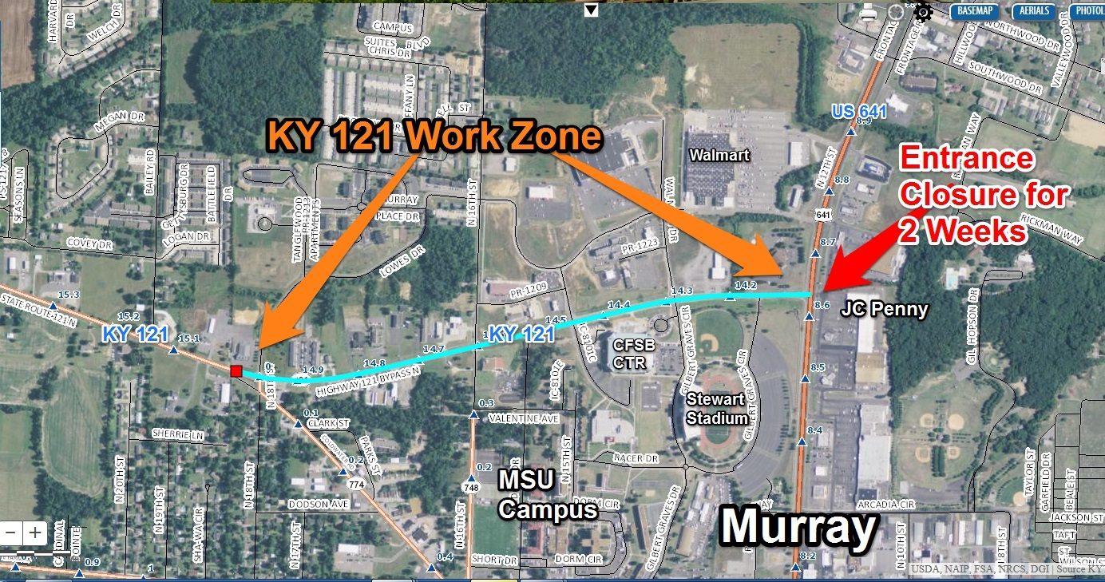
Traffic Restrictions begin September 19, 2016.
For more information visit: www.facebook.com/kytcdistrict1

Slide 2
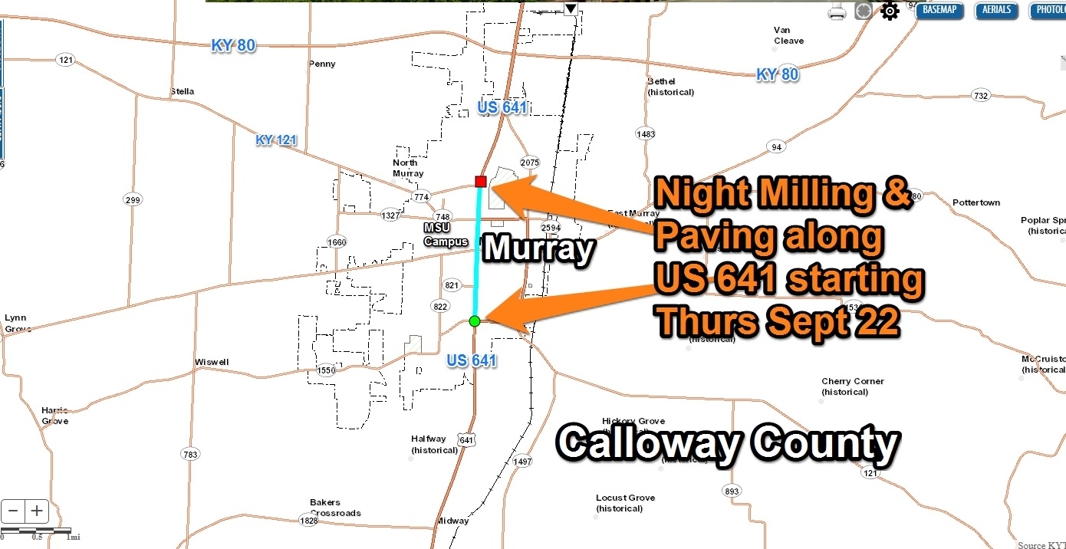
Traffic Restrictions begin September 22, 2016.
For more information visit: www.facebook.com/kytcdistrict1

Slide 3
TRAFFIC ADVISORY
For more information visit: www.facebook.com/kytcdistrict1
A contractor for the Kentucky Transportation Cabinet plans to open the KY 121 work zone on 11-21-16 and 11-22-16 to allow traffic to run on base courses of asphalt during the winter months, then return in spring to place a final driving surface.
After Thanksgiving, there will be short intermittent lane restrictions to allow finish concrete work and roadway lighting.

Slide 4
TRAFFIC ADVISORY
A portion of KY 2594 on Thursday morning 5/30 from 6am – 6pm. Saputo will be replacing a 20,000 gallon silo which should take no more than 12 hours. Just as last time the road should be closed with detour at 4th and Chestnut and 94/Industrial Rd.

